Slide 1
Navigating the Care Environment
Introducing the Arts in Healthcare Environments

Slide 2
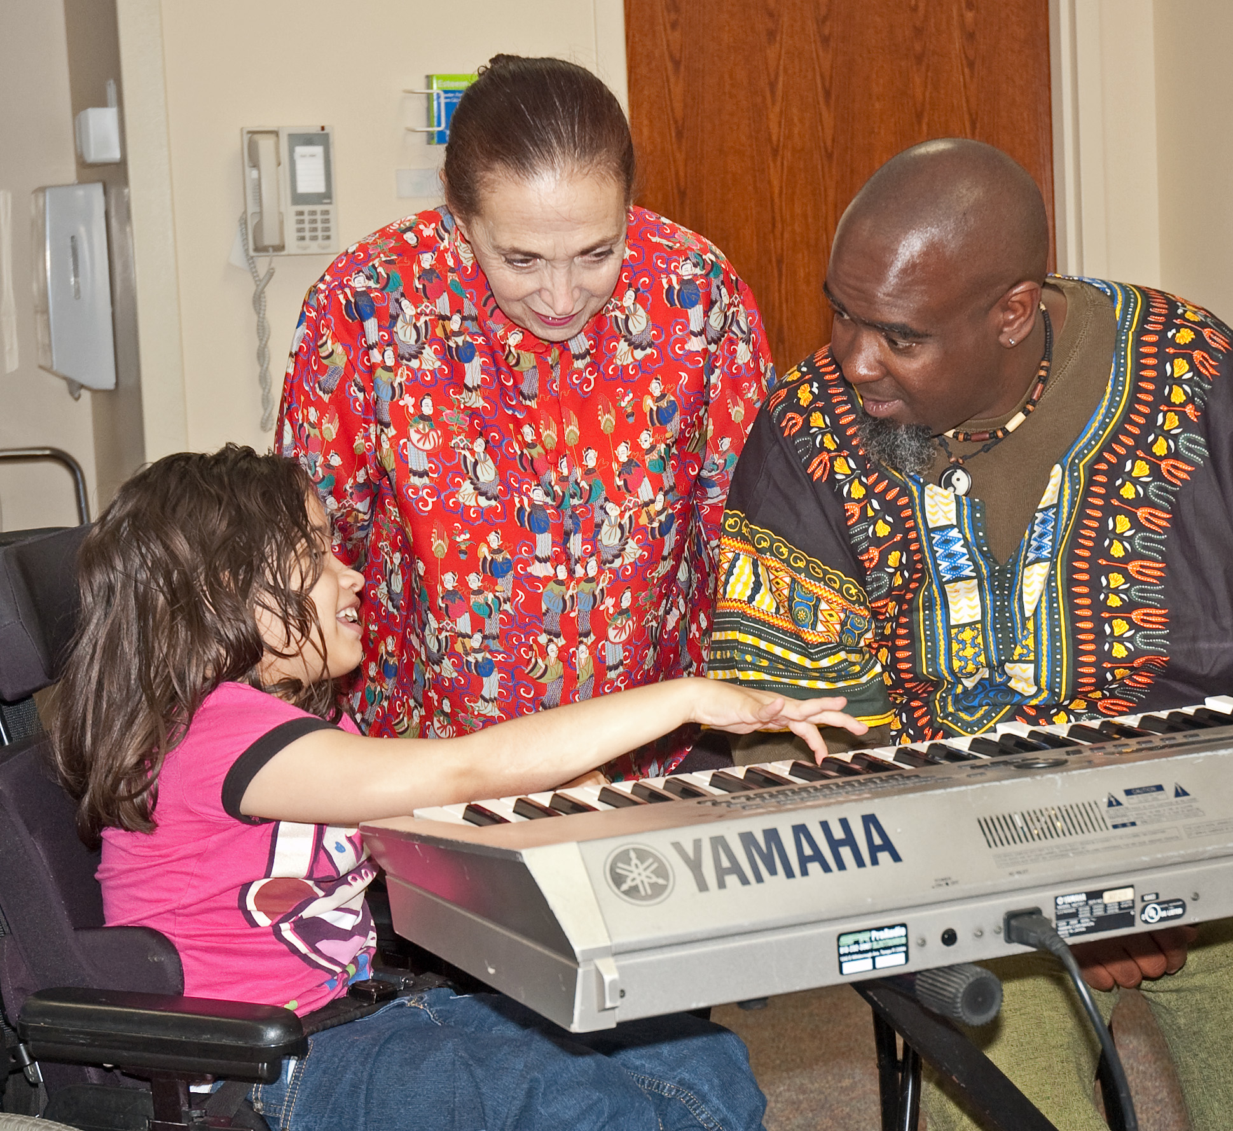
Overview
What is your care environment?
Who’s who in healthcare
What is the artist’s role?
Participant Safety
Healthcare policies
Healthcare communications
Troubleshooting

Slide 3
It’s not just the hospital
Creating an understanding of roles and responsibilities in every care environment

Slide 4
Who’s Who in Healthcare?

Slide 5
Navigating the Healthcare Setting (may include hospital, health department, clinic, long term care, hospice, home care environments)
Family members and loved ones
Artist in Residence
Leadership team
Creative Arts Therapist
Rehab team: OT/PT/Speech Unit Director + Charge Nurse + Nursing Physician Social Worker Case Manager Child Life Chaplain Activities Director Recreational Therapist

Slide 6
What is the artist’s role in the care environment?
Facilitate creative experience
Share basic knowledge and love of primary discipline such as visual, performing or literary arts
Connect in a way that respects participant while creating rapport and establishing relationship
Consistency and reliability (schedule, dress, communications)
Proper care for supplies

Slide 7
Participant Safety
Confidentiality
Infection Control (handwashing, care for art supplies, appropriate contact, stay away when sick)
Consent for participation, documentation, photographs
Consistent communications and accountability
Incident reporting
Time reporting

Slide 8
Policies and Governance
Joint Commission - An independent, not-for-profit organization, The Joint Commission accredits and certifies more than 19,000 health care organizations and programs in the United States.
HIPAA - Health Insurance Portability and Accountability Act (1996)
Governs privacy standard for health information
Don’t discuss participant information in public spaces.
Don’t photograph or document without signed consent.
.
Notes:
Do not discussing personal information in public spaces, including elevators.
Shred any patient information, room numbers and names, before leaving the building
Do not take any photographs or record video.

Slide 9
Communication
Clear, respectful communication procedures
Memorandum of agreement to formalize communications
Professional and timely phone and email correspondence with participants and leadership
Representing arts programs accurately
Communicating absence or change of schedule

Slide 10
Troubleshooting
What happens when . . .

Slide 11
Questions?

Slide 12
Facilitating the Arts in the Care Environment

